Slide 1

SD-04 — SUSTAINABLE DEVELOPMENT
Circular Economy Marketplace
AI-Powered Platform for Reusing Industrial Materials
AI Classification
Industrial Waste
Digital Marketplace
Reuse → Future
Project Category
Project Theme
Presented By
Sustainable Development
Circular Economy & Industrial Waste Reuse
Anshuman Verma · Aman Kumar · Anish Prakash · Aditya Verma

Slide 2






PROBLEM · OBJECTIVES · SOLUTION
Problem, Objectives & Proposed Solution
Existing Problems
Our Objectives
Reusable industrial materials are often treated as waste
Create a digital marketplace for reusable materials
Industries struggle to find buyers for surplus materials
Connect suppliers and buyers across organizations
No trusted, centralized exchange platform exists
Use AI for automated material classification
Material classification is difficult and time-consuming
Track ownership and transactions transparently via blockchain
Limited visibility into environmental impact of reuse
Calculate carbon & environmental impact of reuse
Ownership and transaction history hard to verify
Encourage reuse and reduce industrial landfill waste
Core Modules
User Management
Carbon Analytics
Marketplace

Slide 3







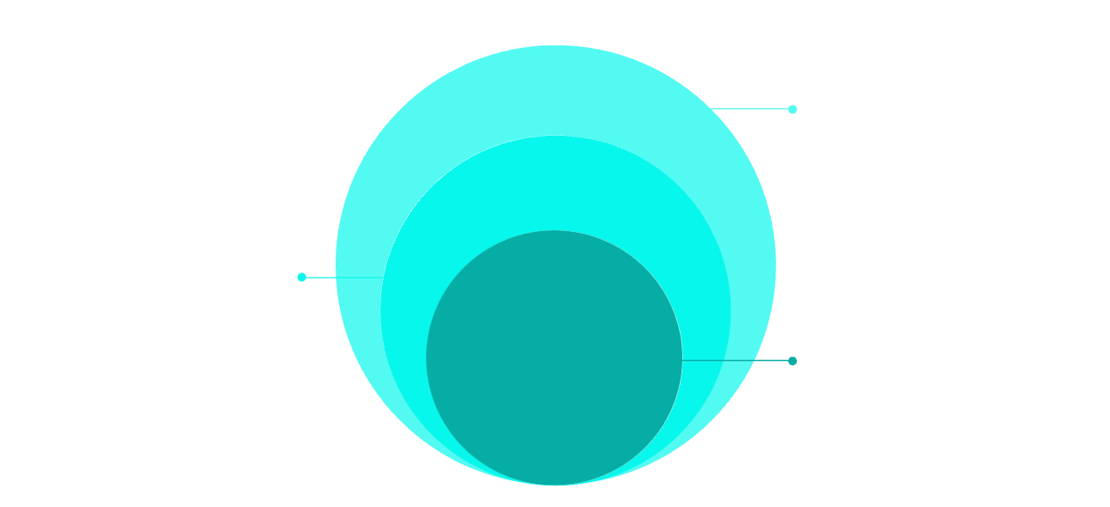
TECHNOLOGY STACK
Tech Stack & Why Each Technology Is Used
HTML
Structure of web pages — forms, listings, dashboards, navigation & marketplace components
CSS
Responsive layouts, typography, card UI, animations — desktop & mobile compatible
JavaScript
Frontend interactivity, search/filter, form validation, dynamic updates & API communication
Python
AI/ML material classification, data processing, carbon-impact calculations & backend API
Database / Backend
Firebase / MongoDB — authentication, user profiles, material listings & transaction data
Blockchain
Solidity smart contracts on Ethereum-compatible testnet — ownership records & transaction verification
AI & Ledger
Python AI service integrated with blockchain smart contracts
Backend & DB
API, business logic, and persistent storage
Core Web App
HTML, CSS, JavaScript for UI and interactivity

Slide 4

SYSTEM WORKFLOW
How the System Works
Register
List Material
Create account and verify organization profile.
Upload item details: name, qty, condition, images.
AI Classifies
Marketplace
Automatically categorize material by type and quality.
Make listings discoverable to buyers and partners.
① Registration
② Material Listing
③ AI Classification
④ Marketplace
Organization creates account & verifies profile
Supplier uploads name, quantity, condition, location, images & price
Python AI categorizes material: Metal, Plastic, Glass, Electronics, Industrial Surplus…
Buyers search, filter by category/location/quantity, view details & contact supplier
⑤ Transaction
⑥ Blockchain Record
⑦ Carbon Impact
Both parties agree; transaction is recorded on the platform
Smart contract stores verifiable ownership & transaction history
System estimates environmental benefit vs. producing or discarding new material

Slide 5




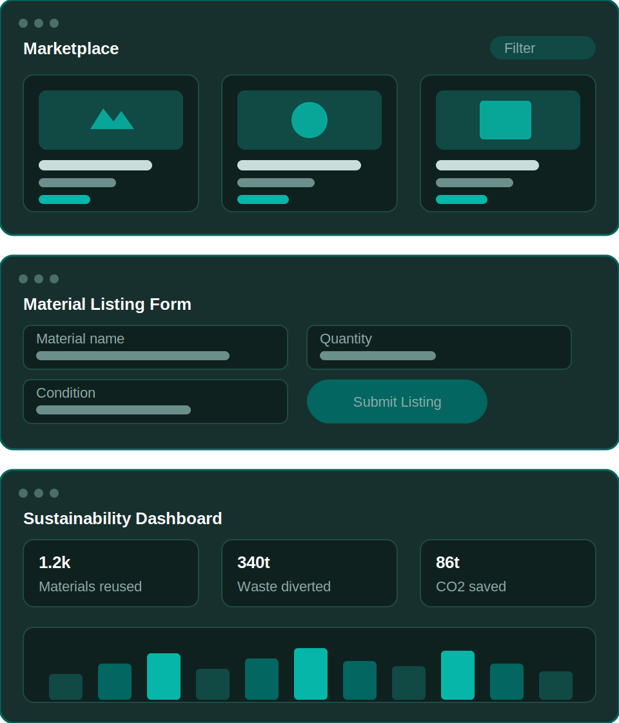






PLATFORM MODULES
Key Features & User Interface
Supplier Dashboard
Mock UI Screens
Add & manage listings · View buyer requests · Track transactions · Monitor environmental impact
Marketplace · Material Listing Form · Sustainability Dashboard
Buyer Dashboard
Search & filter materials · View details · Request material · Track purchases
AI Module
Image & text-based classification · Auto-categorization · Material recommendations
Marketplace
Material cards · Search · Category, location & quantity filters · Price info
Sustainability Dashboard
Materials reused · Waste diverted · Carbon reduction estimate · Transactions completed
Admin Dashboard
Manage users · Verify organizations · Monitor listings & transactions · Analytics

Slide 6


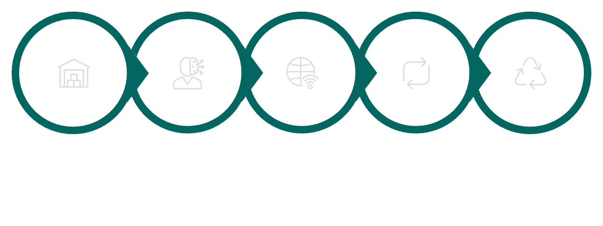
IMPACT & FUTURE SCOPE
Impact, Advantages & Future Scope
Expected Impact
Future Scope
🌍 Environmental
1
IoT Integration
Reduce industrial waste · Increase material reuse · Lower landfill dependency · Support circular economy
Automatic inventory tracking for industrial materials
2
Advanced Computer Vision
💰 Economic
AI-based material identification from images
Organizations recover value from surplus · Buyers access materials at lower cost · New digital exchange ecosystem
3
AI Price Prediction & Recommendation
Connect buyers with relevant materials automatically
🖥️ Technological
4
GPS-Based Matching
AI-assisted classification · Transparent digital ownership records · Data-driven sustainability analytics
Location-aware supplier-buyer pairing
5
Mobile App & National Network
Expand into a national industrial circular-economy platform
Surplus
AI Classify
Digital Market
Reuse
Impact

Slide 7





CONCLUSION
Thank You
"From Industrial Waste to Digital Resource."
The Problem
Our Solution
The Impact
Reusable industrial materials end up as waste due to lack of a trusted digital exchange ecosystem
A centralized AI-powered marketplace connecting suppliers & buyers of reusable industrial materials
Reduced landfill waste · Economic value recovery · Transparent blockchain records · Carbon analytics
Anshuman Verma
Aman Kumar
Anish Prakash
Aditya Verma

